Slide 1
STUDY AND CONTROL OF WEAK GRID CONNECTED MATRIX CONVERTER BASED DFIG SYSTEMS
SSN College Of Engineering
Kalavakkam
1

Slide 2
PRINCIPAL INVESTIGATOR
Dr Ranganath Muthu
CO - INVESTIGATOR
Mr. M.Senthil Kumaran
2

Slide 3
Objective…..
To develop a Controller for Direct power control of DFIG Systems with a Matrix Converter.
To analyze the Matrix Converter for unbalanced conditions , common mode voltage problems, voltage ride through issues & Simplified Modulation technique.
3

Slide 4
Phase - I
SIMULATION
Study and Simulation of Matrix Conveter in MATLAB/ Simulink
Design and Simulation of The Direct Power Controller for the Rotor Side Control of DFIG in MATLAB/ Simulink.
HARDWARE
Developing a Matrix Converter for a Doubly - Fed Induction Generator (DFIG) using Discrete Components [ IGBTs, DRIVER ICs.... etc.]
Developing a Controller for Direct Power Control of Matrix Converter based DFIG system using FPGA
4

Slide 5
Matrix Converter - Simulation
&
Space Vector Technique
5

Slide 6
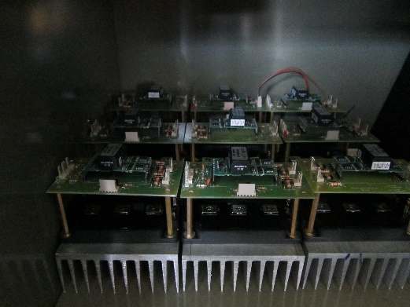
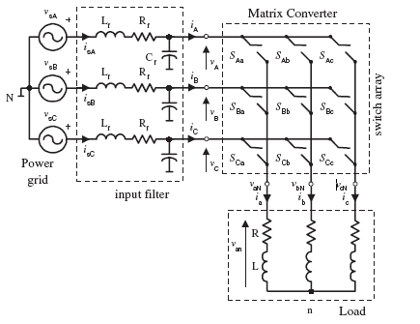
Matrix Converter
Elimination of DC Link – Problems of DC Bus Voltage maintenance
Bi-directional real power transfer, Improved power Quality.
Features that makes Matrix converter an alternative to conventional Back to Back Converter Systems
Disadvantage
Complex Control Strategies
Needs a High Speed Controller for a Real Time Control
6

Slide 7
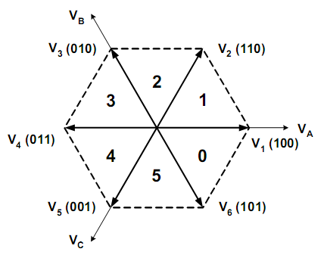
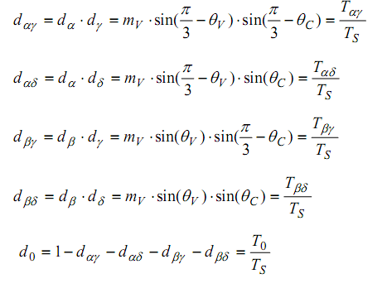
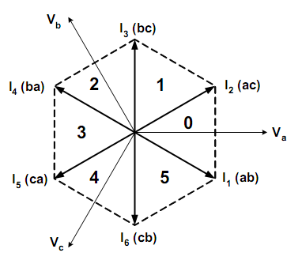
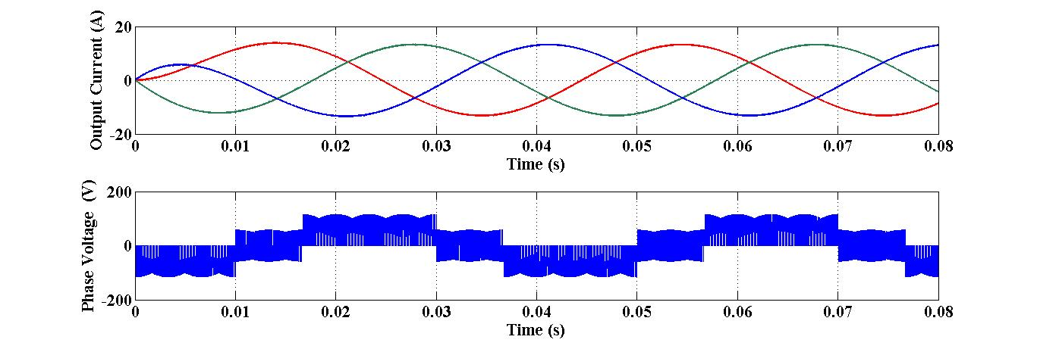
Space Vector Modulation For MC
7

Slide 8
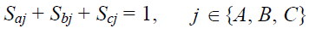
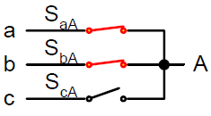
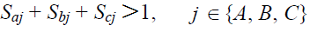
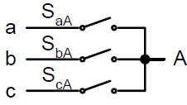
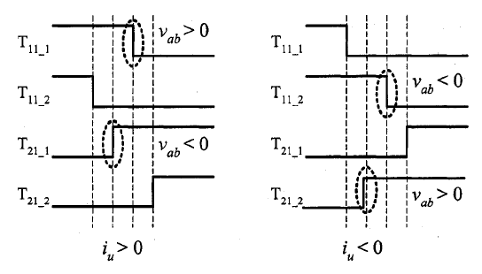
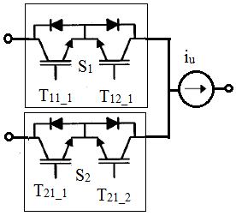
Commutation of the Bidirectional Switch
absence of inherent free wheeling in Matrix Converter
Basic rules for safe operation of the Matrix Converter { }
No two switch of the same output phase should be ON
2) Not all the switch of an Output phase should be open
Methods of Commutation
Multi Step Current Commutation ( Requiring direction of Output Current)
Dead Time Commutation
( Requiring Snubber Circuit )
8
Notes:
The absence of inherent freewheeling path in matrix converter leads to commutation issues.
In this work the four step commutation strategy is used to address this issue.

Slide 9
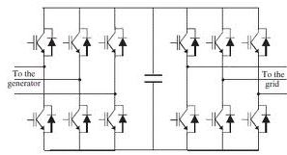
Comparison of MC with conventional Back to Back Converter
No DC link Capacitor
Presence of DC link Capacitor
Single Stage Conversion with greater Conversion Efficiency
Two Stage Conversion with less Conversion Efficiency
Only three switches conduct at a time
Six switches conduct along with the DC link capacitor at a time
Commutation issues are addressed using Four step commutation method and Clamp circuit
Commutation issues are addressed using simple Dead time Technique
Buck type converter
Buck and Boost type converter
9

Slide 10
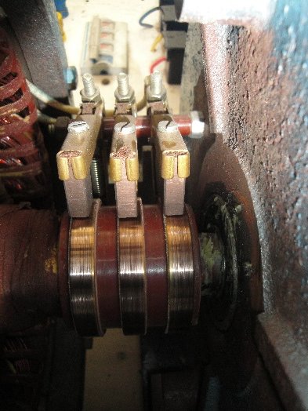
DFIG Modeling
&
DFIG Parameter Determination
10

Slide 11
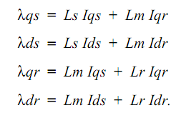
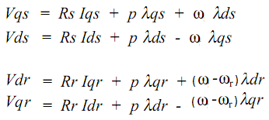
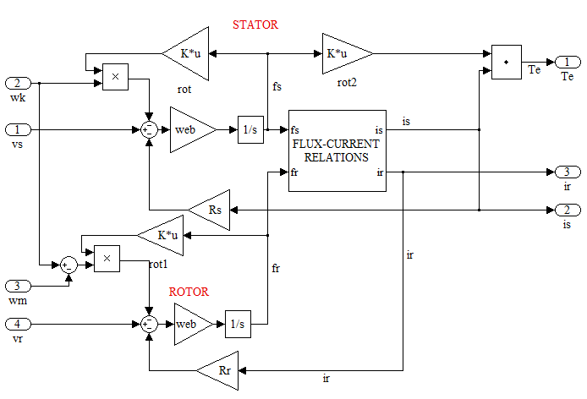
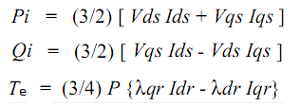
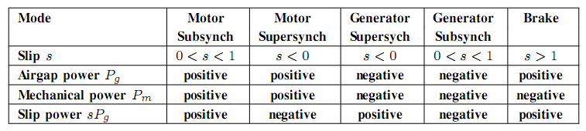
Doubly Fed Induction Generator Model
Machine Equation in arbitrary frame of reference
11

Slide 12
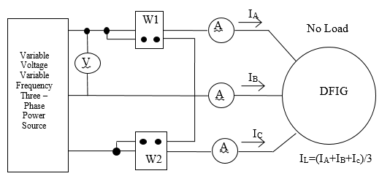
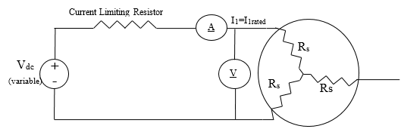
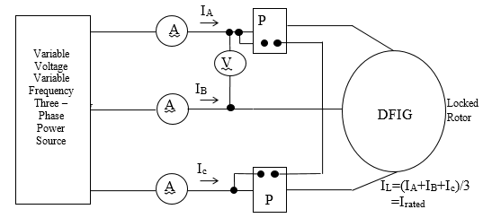
DFIG Model – Parameter Determination
DC – Test
For Rotor and Stator Resistance
No Load Test
For Magnetizing Reactance
Blocked Rotor – Test
For Rotor and Stator Reactance
12

Slide 13
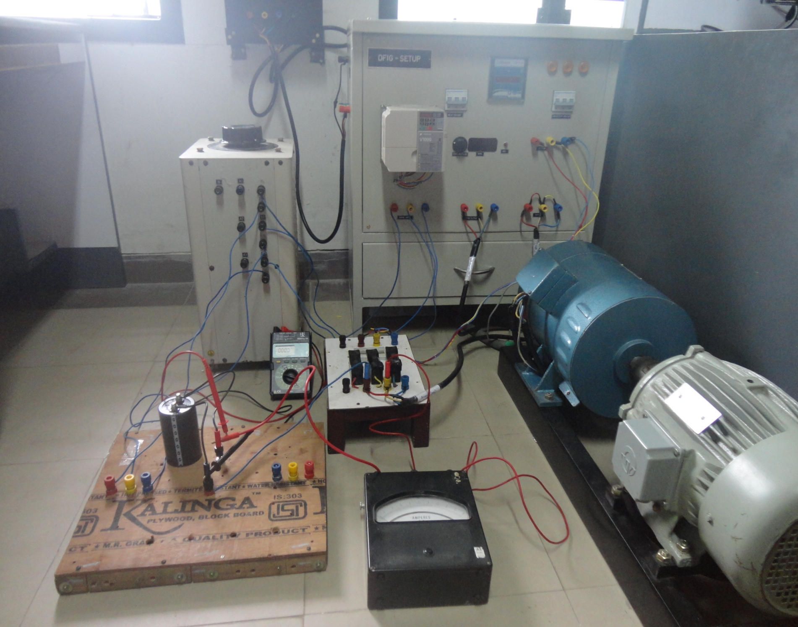
DFIG DC test, No load Test and blocked rotor Experimental - test setup
13

Slide 14

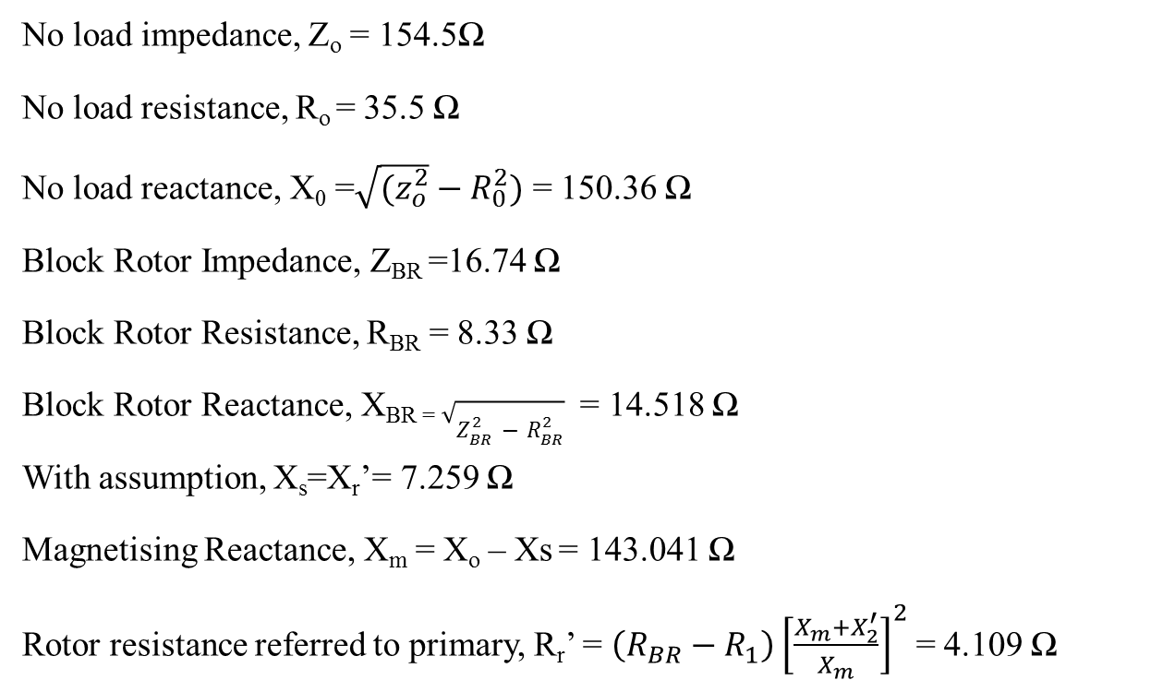
Determined DFIG Parameter
No load impedance, Z_{o} = 154.5Ω
No load resistance, R_{o} = 35.5 Ω
No load reactance, X₀ =$\sqrt{(z_{o}^{2}}−R_{0}^{2})$ = 150.36 Ω
Block Rotor Impedance, Z_{BR} =16.74 Ω
Block Rotor Resistance, R_{BR}= 8.33 Ω
Block Rotor Reactance, X_{BR =} $\sqrt{Z_{BR}^{2}−R_{BR}^{2}}$ = 14.518 Ω
With assumption, X_{s}=X_{r}’= 7.259 Ω
Magnetising Reactance, X_{m} = X_{o} – Xs= 143.041 Ω
Rotor resistance referred to primary, R_{r}’ = $\left(R_{BR}−R_{1}\right){\left[\frac{X_{m}+X_{2}^{′}}{X_{m}}\right]}^{2}$ = 4.109 Ω
14

Slide 15
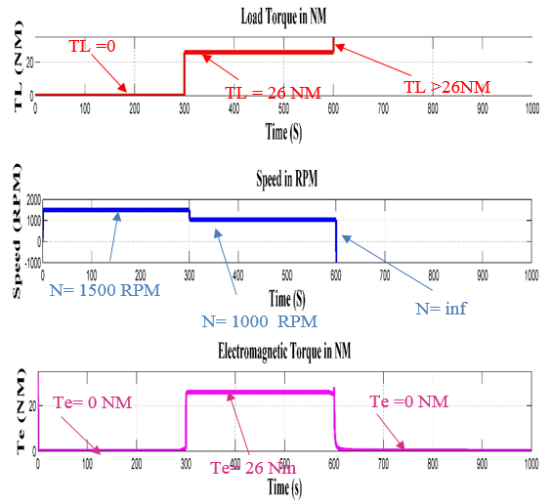
Validation of Determined Parameters through Simulation
15

Slide 16
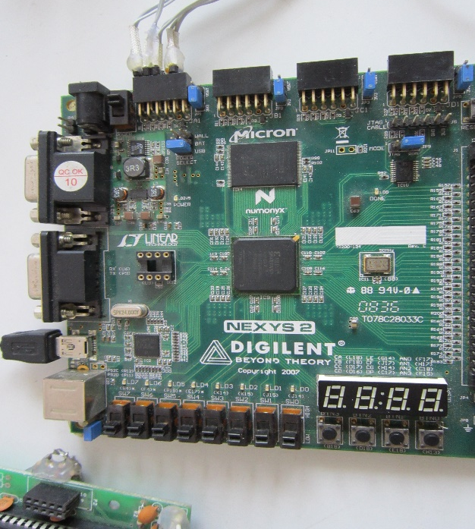
Controller for Matrix Converter
16

Slide 17
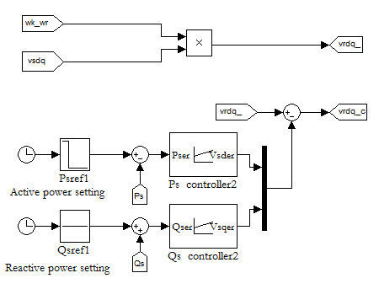
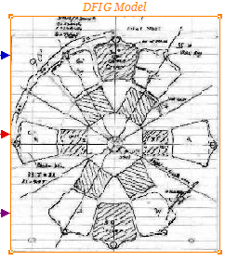
Controller Design
Stator Power - Controller Design
Sub Synchronous Mode of Operation
Super Synchronous Mode of Operation
Two PI Controllers with the error signals generate rotor voltage Reference signal for the Matrix Converters Modulation Algorithm.
Note:
Variable Speed Operation – Under Rated Wind Speed
17

Slide 18
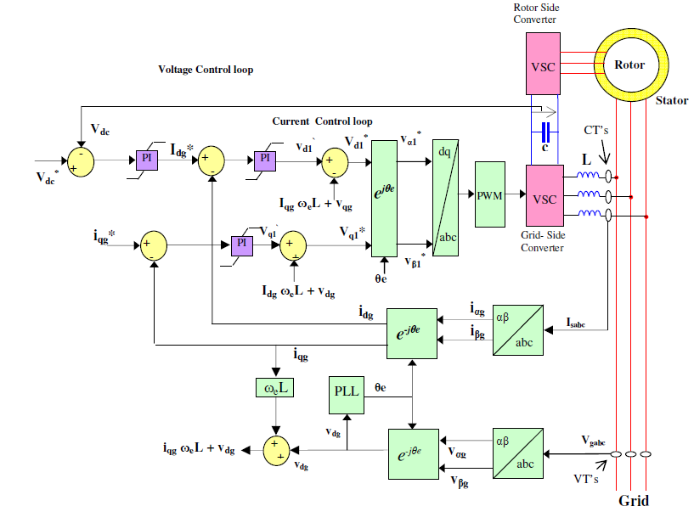
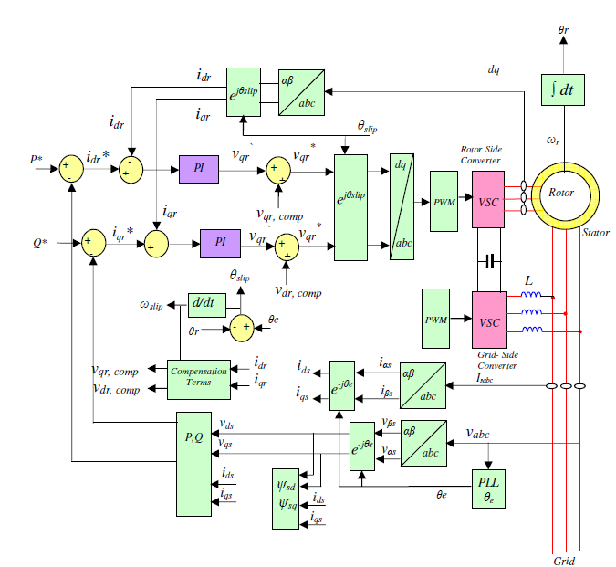
Comparison of Controller for MC and Back to Back Converter for DFIG systems
Grid Side controller of B- B Converter
Rotor Side controller of B- B Converter
Absence of Grid side controller for
Matrix converter
Rotor Side controller
of Matrix converter
18

Slide 19
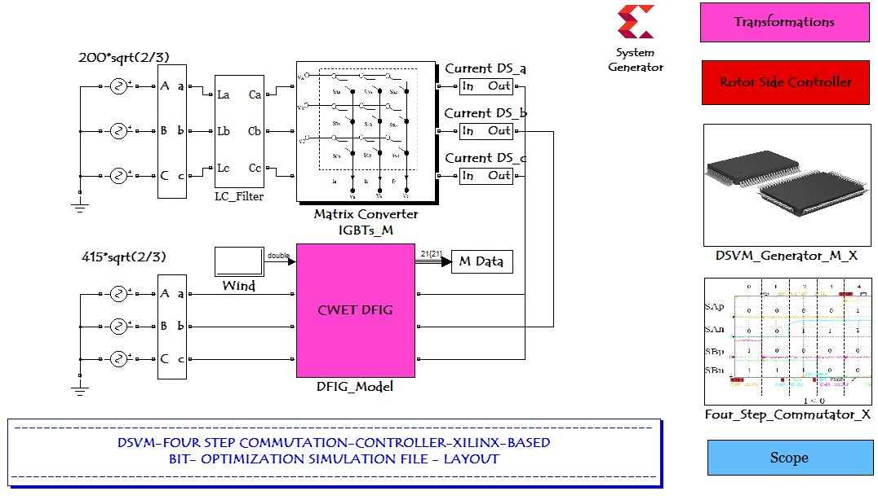
Simulation of Direct Power Control (DPC) in DFIG using Matrix Converter- Matlab/Simulink
19

Slide 20
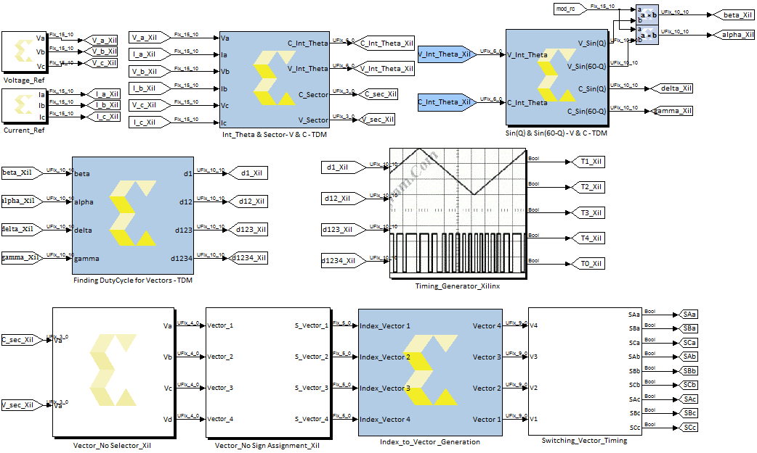
Xilinx-System Generator Coding of the DSVM Generator
20

Slide 21
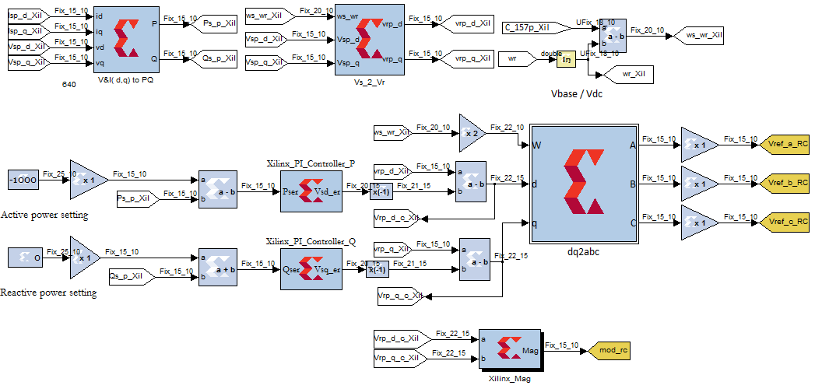
Xilinx-System Generator Coding of the Rotor Side Controller
21

Slide 22
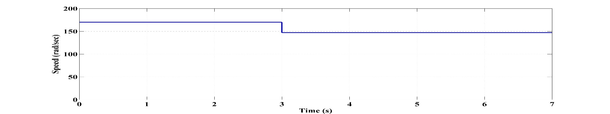
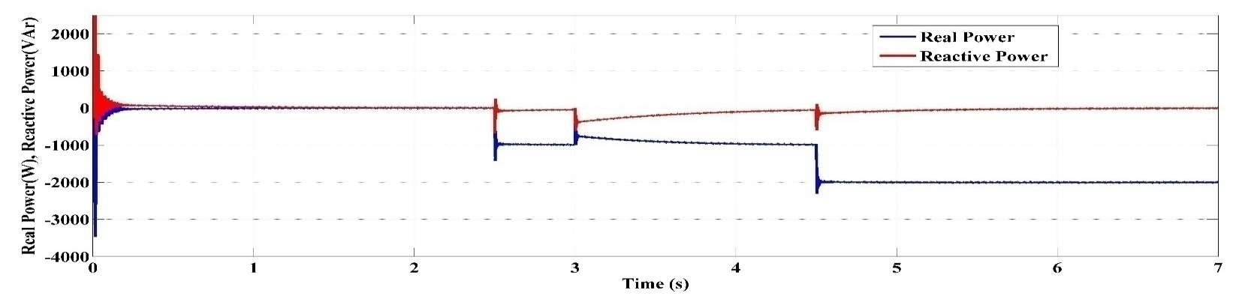
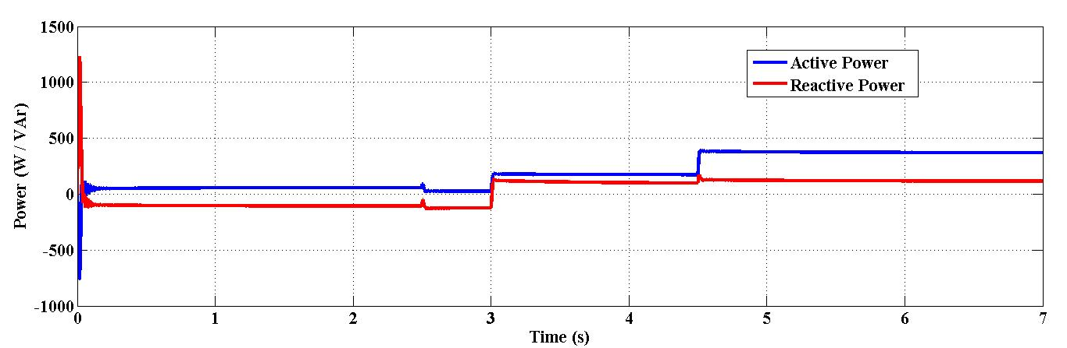
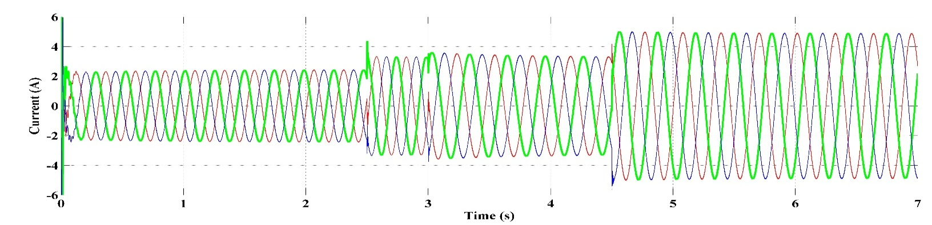
Simulation With a Matrix Converter in DFIG
Speed
Stator Power
Matrix converter Switching frequency 5KHz
Rotor Power
Rotor Current
22

Slide 23
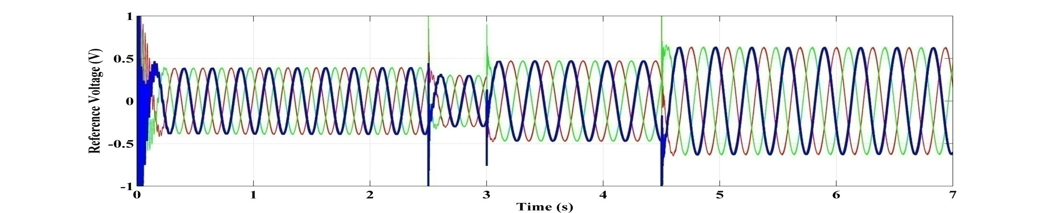
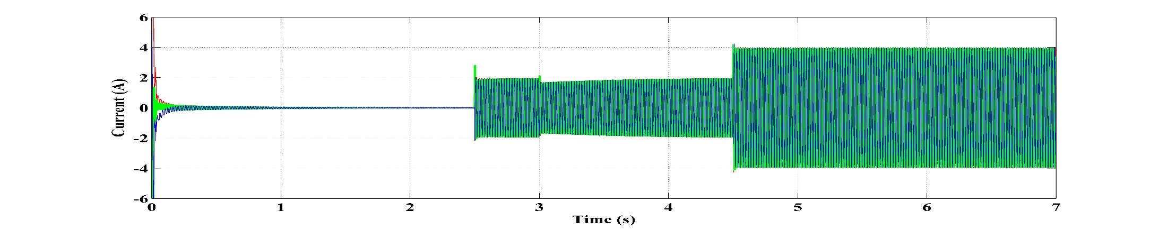
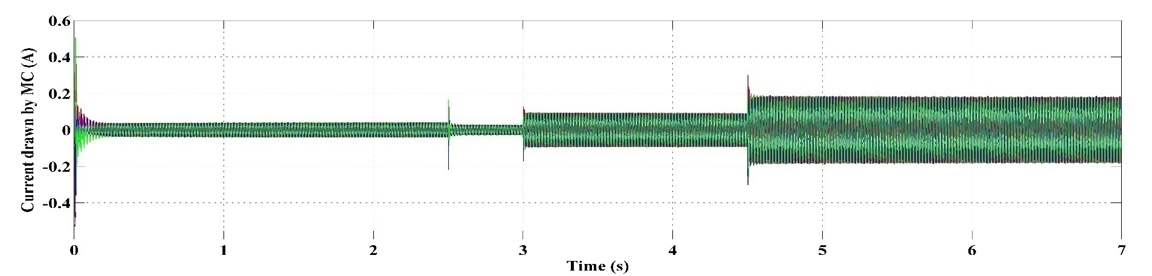
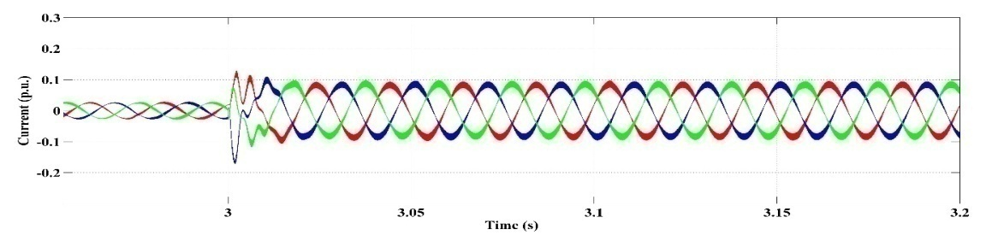
Simulation With a Matrix Converter in DFIG
Reference V
Stator Current
MC Input Current
23

Slide 24
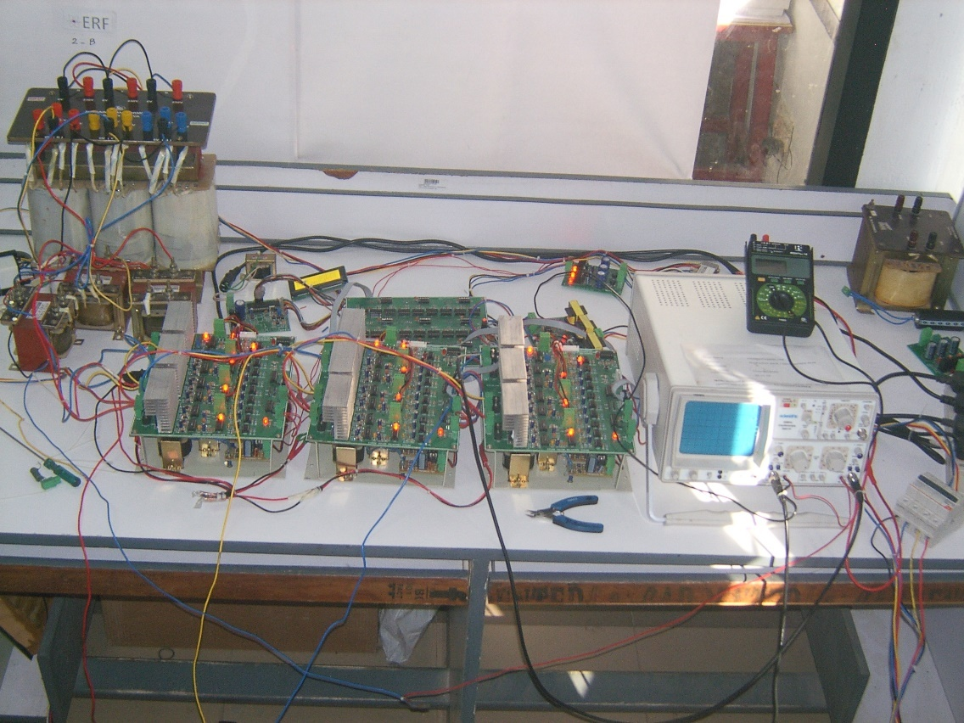
Hardware Development
Matrix Converter & Controller
24

Slide 25
Matrix converter
Power module
Power Switch - IGBT – CT60AM
[ Frequency and amplitude conversion]
Driver IC - IR2112
[To amplify the signal Level pulses to power Level]
Opt coupler – NE137
[Electrical Isolation between the FPGA Pulses ad the Power module]
25

Slide 26
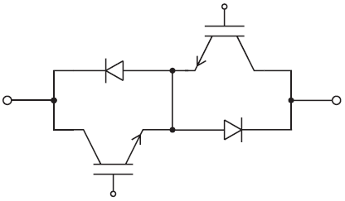
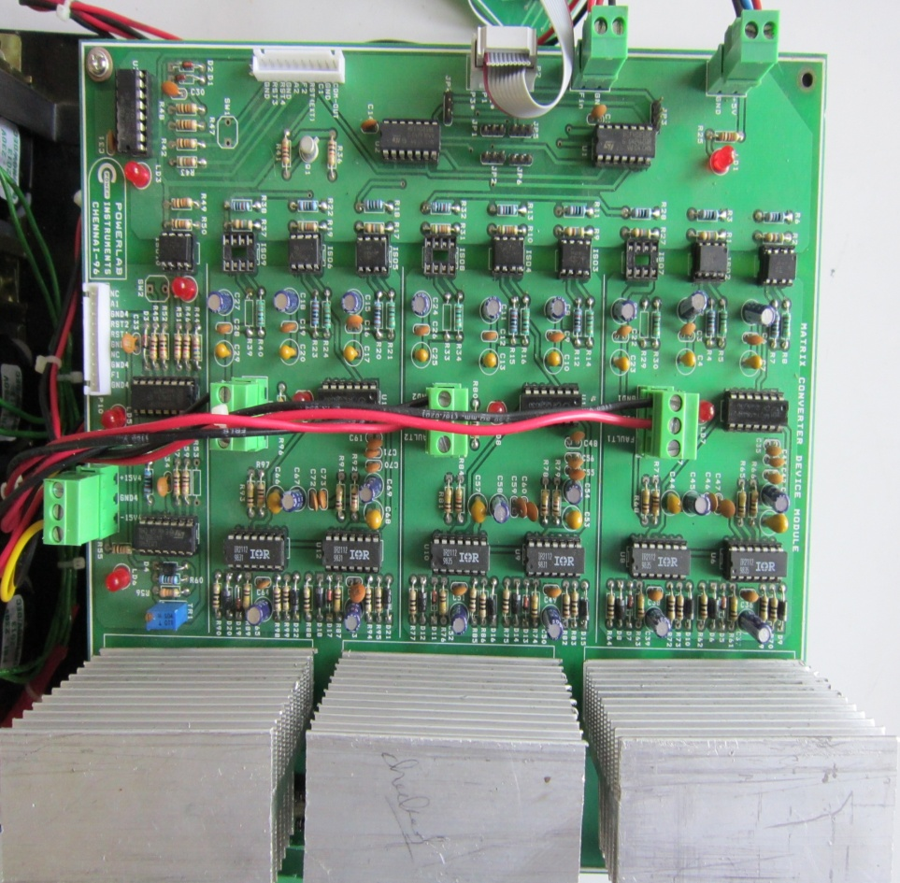
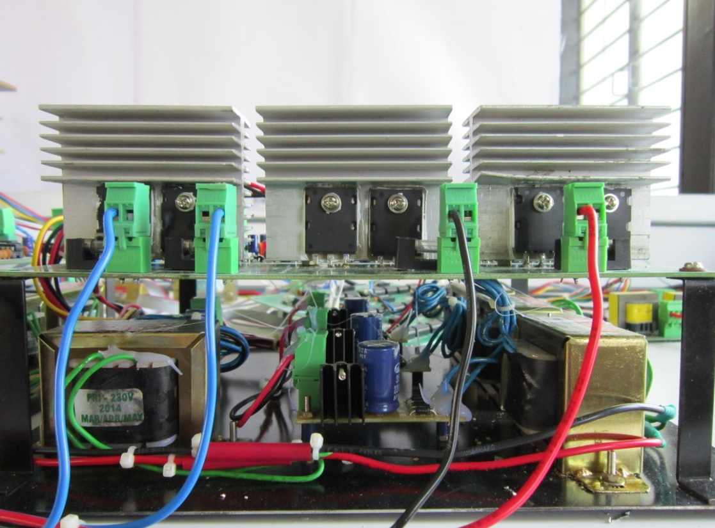
Matrix converter
Power module
IGBT - CT60AM
Driver – IR2112
Opto – NE137
Front View of the single arm of the MC
Top View of the single arm of the MC
26

Slide 27
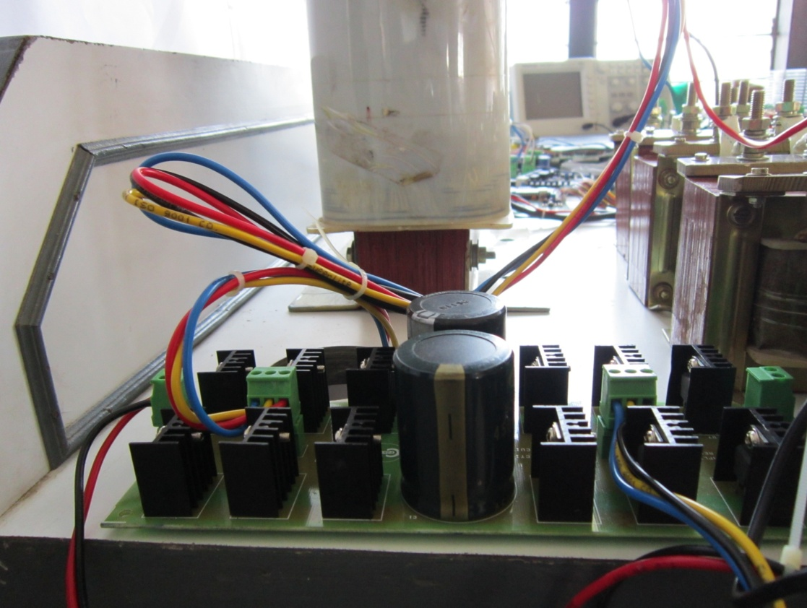
Matrix converter
Clamp Circuit
Clamp Capacitor Value – 1100 uf
Discharge Resistance – 100 Ohms
High frequency Diode – MUR 860
In addition the energy available in the Clamp capacitor is used by a Dc fan for cooling the IGBTS
Side View of the Clamp Circuit
27

Slide 28
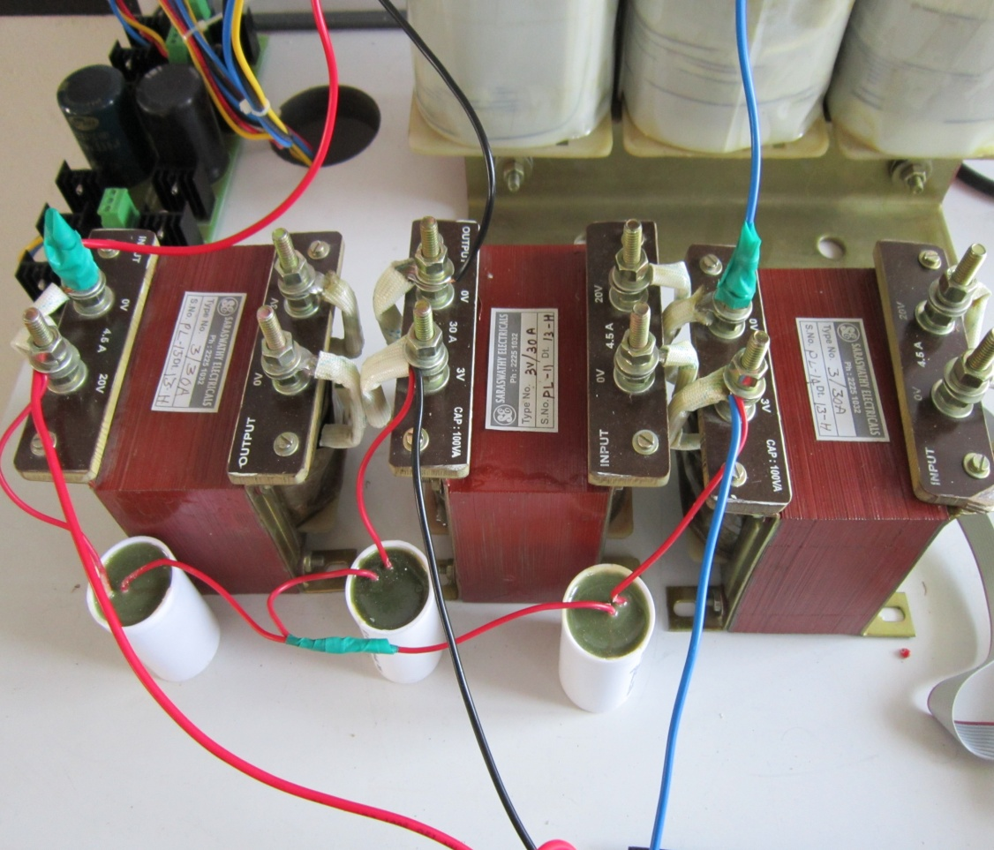
MC -
Input Filter Circuit - LC
Filter Capacitor Value – 20uf
Filter Inductance Value – 4mH
Top View of the Input filter Circuit
28

Slide 29
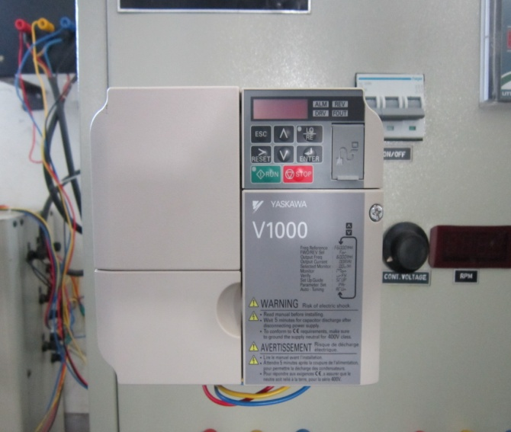
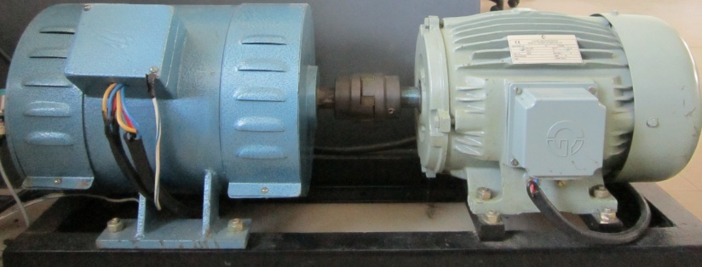
DFIG -
Prime mover & Control
Generator
DFIG – Ramson
3 Hp
VFD for the controlling the
Speed of the Prime Mover
Prime mover
SFIM– Crompton greaves
5 Hp
VFD
V1000– Yahasawa
(0-60 )Hz
29
Front View of DFIG , Prime Mover & its Control

Slide 30
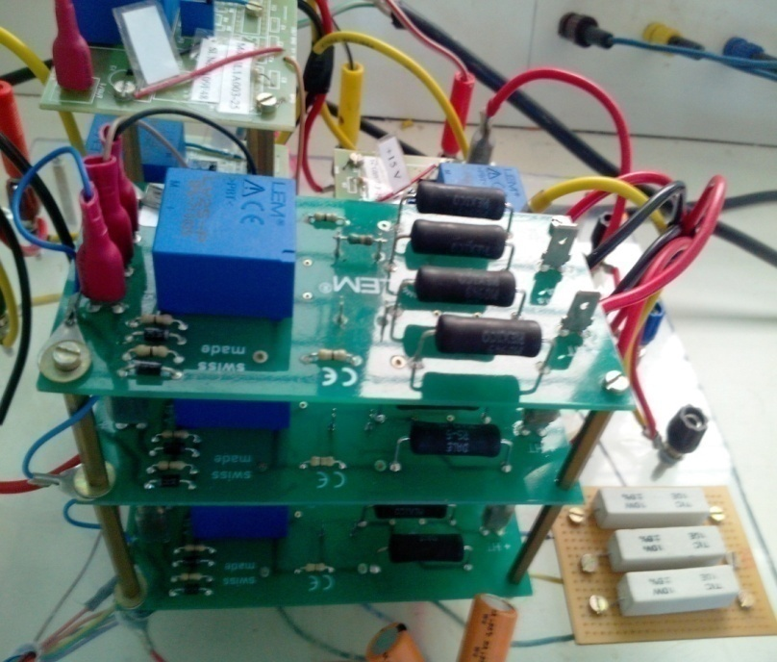


Data Acquisition
ZCD-Current reference
ZCD Eliminates the Voltage Sensors that are required to maintain UPF in matrix converter
ZCD – implementation
Step-down transformer – (230V to 5 V)
Comparators - 741 – Opamp
Speed Unit
Speed is sensed form the VFD unit.
30

Slide 31




Data Acquisition -
Transducers & ADC
Power-Transducer
Make: Meco
Input – 450V, 5A - (AC)
Output – (0- 5)V - (DC)
Voltage - Transducer
Make: Meco
Input – 450V - (AC)
Output – (0- 5)V - (DC)
ADC - Pmod- AD1
ADC- 7476 [ 12 bit ADC]
Stalin Key Filter
1 MSPS ,
Input -(0-3.3)V
31

Slide 32

Controller -
FPGA – SPARTAN – 3E
FPGA
Spartan 3E
500 thousand Gates
ADC
Programming
VHDL
5V to 3.3 V
Converter
Code Generation
Xilinx – Matlab interface
System generator
4
P , Q , Speed & Voltage
Analog signals (0-5V)
18
DSVM
Power Controller
Digital signals (0-3.3V)
Pulses to Matrix converter
Digital Signals(0-3.3V)
ZCD Signals
32
Front View of FPGA Controller

Slide 33













Interconnection of Individual Hardware Units
POWER TRANSDUCER
ADC
FPGA
DRIVER
VOLTAGE TRANSDUCER
ADC
MC
SLIP SPEED
DFIG
SFIM
VFD
33
GRID
POWER
PANEL

Slide 34

MATRIX CONVERTER – MODULE
[Power switches, Clamp , Input Filter , ZCD and FPGA ]
34

Slide 35

DFIG and MATRIX CONVERTER SETUP
[Matrix converter, DFIG, Prime mover, VFD and Controller ]
35

Slide 36




Hardware results
Matrix converter - Space vector Modulation technique
R - Phase output Voltage
R- Phase Input Current
R- Phase output Voltage - Zoomed
36
R- Phase output Current

Slide 37




Matrix converter in DFIG systems - Power control
super synchronous mode
Reference power – 1000 Watts – rotor speed -1560 rpm
Rotor Current [MC-Output]
Rotor Voltage injected at slip frequency
Rotor voltage injected - Zoomed
MC Input Current
37

Slide 38


Power control
Reference power – 1000 Watts – rotor speed -1560 rpm
super synchronous mode
Stator Power
Reference power – 1000 Watts – rotor speed -1470 rpm
Stator Power
Sub synchronous mode
Oscillations appear at the stator power
38

Slide 39
Conclusion
Matrix converter based Direct power control of DFIG yields the following advantages
Simple Controller Design / Compared to the Conventional Back to Back Converter.
Elimination of DC Link Capacitor.
Greater efficiency.
Compact Circuit.
The following disadvantages are present
Complex switching algorithm
Four step commutation issues
Stability issues of Matrix converter.
39
Notes:
The summary of the unbalance analysis is given

Slide 40

Phase - II
Study of Unbalance, Common mode and Ride through in Matrix Converters
Attempt in development of simple switching strategy for Matrix converter to make it a industrial possibility.
40

Slide 41
Completed
1) Developing methods to analyze the control of matrix converter under unbalanced conditions.
“MATRIX CONVERTER Switching Strategy for abnormal voltage conditions using selective harmonic tracking algorithm” Published in International journal of simulation and modeling - ACTA PRESS
41

Slide 42

Analysis of the effects of unbalanced inputs in Matrix Converter
Analysis of the Fictitious DC bus Voltage of the Matrix Converter under unbalanced and non sinusoidal input conditions is carried out.
The simplified control based on the signatures present in the fictitious DC bus for matrix converter operated under unbalanced and non sinusoidal inputs is presented
Simulation results are presented to explain the validity of the proposed method.
42
Notes:
So analysis of mc with non sinusoidal and unbalanced input conditions was performed.
The effect of unbalance on the fictitious DC bus was analysed and the compensation technique was developed

Slide 43






Effect of Input Unbalance on the Fictitious DC bus
Fourier expression of the Phase voltage is given as
Through the symmetric component method sequence components are derived
The current space vector for Positive Sequence of i^{th} harmonic:
Similarly for Negative Sequence:
The total current space vector f_{i}
Since f₀ =0 for the converter
The fictitious DC bus voltage is given by:
43
Notes:
The unbalance at the input introduces a second harmonic oscillation on the FDC bus in addition to the Dc component.
This is given in the equation.

Slide 44



Effect of Oscillations in the Fictitious DC bus on the output voltage
The input unbalance introduces a second harmonic ripple on the Fictitious DC bus
Hence the synthesized output can be expressed as
Two lower order harmonics appear at the output voltage
44
Notes:
Thus the output synthesized from this FDC can be divided into two components 1) fundamental 2) harmonic
The harmonic component are ( 2we+wo) & (2we-wo)

Slide 45


Effect of Oscillations in the Fictitious DC bus on the input current
The input unbalance introduces a second harmonic ripple on the Fictitious DC bus
Hence the synthesized input current can be expressed as
Lower order third harmonics appear at the input current
45
Notes:
Similarly the input current synthesized from this FDC can be divided into two components 1) fundamental 2) harmonic
The harmonic component are ( 2we+we) & (2we-we), (ie) = (3we).

Slide 46




Unbalance compensation technique
Modulating the switching function of the inverter with the ripple on the DC bus
Voltage and Current Sector Selection
Methods proposed:
A sector correspondence between the input current and the line voltage space vector is established for unity displacement factor (UDF)
The output modulation index (mi) is modified dynamically based on the computed DC link voltage with Rectifier modulation index (m_{c} =1).
Line Voltage and Input Current Sectors
Method:
V_{dc,min} is obtained through a simple memory circuit
46
Notes:
The compensation technique simply traces the oscillations on the FDC bus with the help of rectifier switching and the input voltage.
Then dynamically modifies the inverter modulation index opposite to the oscillations on the FDCV

Slide 47


Simulation Parameters
Input unbalance ratio to voltage transfer ratio
Power factor and unbalance effects on Voltage transfer ratio
47
Notes:
However due to the compensation technique the maximum modulation index of the converter decreases with respect to the magnitude of unbalance.
With one phase completely shutdown the maximum modulation = 0.28
On the other hand the VTR reduces with input power factor also….

Slide 48
Unbalance Control of Matrix Converter - Simulation Parameters
UB
R-L Load | R_{L} = 2.7Ω , L_{L} = 4.77 mH
Input phase voltage | 100 V
Input voltage frequency | 50 Hz
Input filter | L = 1 mH, C = 35 µF, R_{d} =15Ω
Output Voltage frequency | 40 Hz
Switching frequency | 6 kHz
Unbalance at the input | 10% unbalance in B-phase + 2nd and 3rd harmonics
48
Notes:
The simulation parameters are given above.

Slide 49

Simulation results – unbalance compensation technique
Modified m_{v,comp} for (a) f=20Hz, (b) f=40Hz, (c) f=50Hz,
(d) f=75Hz, & (e) f=100Hz
Input Voltage
Fictitious DC bus Voltage
Input Current
Output phase Voltage
49
Output Current
Notes:
Unbalance is introduced at 0.1s and we find the oscillations in the fictitious DC bus starts with input unbalance
we find that the output current is balanced

Slide 50

Harmonic characteristics - Simulation results
Input Voltage 50 Hz , Output Voltage 25 Hz
Input Current spectrum before compensation
Output Current spectrum before compensation
Input Current spectrum after compensation
Output Current spectrum after compensation
50
Notes:
Seeing the harmonic spectrum of the input and output current before and after compensation.
We see that the output unbalance is Compensated and the lower harmonics are eliminated.
But dose not reduce the input current harmonics- rather it increase the THD.

Slide 51
SUMMARY
Analysis of the effects of unbalance at the input voltage on the Fictitious DC bus, Input Current & Output Voltage was carried out.
It was found that the Fictitious DC bus appeared with oscillations under unbalance.
A Simple Compensation based on the Oscillations in the Fictitious DC bus was proposed
The Simulation results of the Matlab – Simulink model is presented
51
Notes:
The summary of the unbalance analysis is given

Slide 52
Completed
2) Finding out an improved modulation Technique to reduce the common mode voltage ….{Reported as the cause of early winding failure} & extend the operation of matrix converter in over modulated regions.
“Elimination of common mode voltage in matrix converters with improved voltage transfer ratio” Published in International journal of Computational mathematics for electrical engineering” – COMPEL – Emerald publication
52

Slide 53



RSVM Technique for Matrix Converter
Use of the rotating space vector for the elimination of common mode voltage
The MC contains 27 valid direct space vectors. 3 Zero vectors , 18 Standing vectors , 6 Rotating space vectors (RSV).
3 RSV’s move in the clock wise direction and 3 in the opposite direction.
These 6 RSV’s are used for controlling the input power factor along with elimination of common mode voltage
RSV’s applied to MC can only eliminate common mode voltage (CMV) in induction machines.
The use of RSV’s limits the voltage transfer ratio (VTR) to 0.5
The use of 6-phase matrix converter (PSDSMC)for a 3- phase induction machine with increased voltage transfer ratio along with elimination of
CMV is proposed.
53
Notes:
The 6 rotating switching space vector that connect all the input phases to the output phases is used for elimination of common mode voltage along with the input power factor control.
But this limits the voltage transfer ratio to a max of 0.5
Hence the use of 6 phase matrix converters for three phase machines along with its RSVM technique is proposed to increase the VTR to 0.866

Slide 54



RSVM Technique for Matrix Converter
V_{a} +V_{b} + V_{c} = 0 for balanced input:
if all the inputs are connected to all the outputs CMV is eliminated
3 - Clockwise Rotating Space vectors – Switching pattern
The positions of active switching voltage vectors and reference output voltage vector in space
54
Notes:
We find that the switching patterns corresponding to RSV connect all input phases to all output phases.
This means by using only these vectors to synthesize the output voltage common mode can be eliminated.
The position of these RSV and the output reference voltage are given by the equations.
Since both switching space vector and the output reference space vector both rotate the relative theta is used in the SVM tech to synthesize the adjacent vectors.

Slide 55






Using Sine law of triangles
RSVM
Duty cycles of the active and zero vectors are given as
Zero vector synthesis
Modified duty cycle of the RSV
Selection of V₁ , V₂ ,V₃ in each sector
55
Notes:
Using sine law of triangles the duty cycle of the active and zero vectors are calculated as per SVM technique.
But applying zero vectors [ A A A] lead to CMV.
So the zero vector is synthesized by using all the three RSV vectors for equal time.
Hence the zero vector time is shared between all the three vectors.

Slide 56





MI is limited to 0.5 for Sinusoidal output
RSVM
Method for input power factor control
Using + (or) Clock wise rotating vectors.
Using - (or) Anti clock wise rotating vectors.
The output current vector in space is given as
The output current vector in space is given as
The Input current vector in space is given as
The Input current vector in space is given as
The ratio in which the + & - RSV are used brings the control to input power factor within the range of
56
Notes:
We see that using the + RSV the input Current lags the input voltage but when the –RSV are used the input current leads the input voltage

Slide 57



Method for input power factor control
RSVM
Vector representation of Input power factor control
d⁺= Total duty cycle time of + RSV
d⁻ = Total duty cycle time of - RSV
Input power factor θ
57
Notes:
This simply says that the input power factor can be controlled between output power factor to unity by the ratio in which the +RSV and – RSV are used.

Slide 58



Six phase matrix converter (or) PSDSMC with RSVM to improve the modulation index
+ RSV of PSDSMC
- RSV of PSDSMC
58
Notes:
In order to increase the VTR = 0.866
3 additional + RSV are made available by using a six phase matrix converter.
Since the total 6 +RSV are seperated by 60 degrees the VTR is increased to 0.866

Slide 59

Block diagram of the implementation of RSVM in Matlab / Simulink
CMV with SVPWM technique
CMV with RSVM technique
59
Notes:
The block diagram representation of the RSVM for CMC is shown
The CMV induced in SVM technique is high and in RSVM it is completely eliminated.

Slide 60
RSVM - Simulation Parameters
RSVM
R-L Load | R = 5 Ω , L = 12 mH
Input Phase Voltage | 220 V
Input Voltage Frequency | 50 Hz
Input Filter | L = 1 mH, C = 10 µF, R_{d} = 15 Ω
Output Voltage Frequency | 25 Hz
Modulation Index | 0.5 – CMC / 0.866 - PSDSMC
Switching frequency | 7 kHz
60
Notes:
Simulation and hardware parameters are shown above

Slide 61
RSVM - Simulation Results for CMC
Without Power factor control
With Power factor control
Input Current & Input Voltage
Input Current & Input Voltage
Output Line Voltage
Output Line Voltage
61
3-phase Output Current
3-phase Input Current
Notes:
The output of CMC controlled RSVM algorithm without and with power factor control is shown.

Slide 62
Simulation Results of PSDSMC modulated with
RSVM - input power factor controlled
Input Current & Input Voltage
Output Line Voltage
3-phase Output Current
3-phase Input Current
62
Notes:
The output of PSDSMC controlled RSVM algorithm with power factor control is shown.
The increase in the output current compared to CMC case shows that the modulation index increases.

Slide 63
RSVM under unbalance and non-sinusoidal input conditions
RSVM dose not eliminate common mode voltage under unbalanced conditions
RSVM generates a low frequency CMV proportional to the unbalance in case of both CMC & PSDSMC
With non-homopolar harmonics the response of the RSVM is unaffected.
Inputs containing homopolar harmonics the technique fails to eliminate CMV
63
Notes:
Analysis of RSVM technique under unbalanced and non sinusoidal techniques were performed.
It is found that RSVM cannot eliminate CMV under unbalanced inputs and inputs with homopolar harmonic contents.
For non homopolar harmonics the RSVM performance is unaffected.

Slide 64
RSVM – with non –sinusoidal input Conditions
An unbalance of 4.3% in the B phase
CMV of CMC with RSVM
CMV of PDMC with RSVM
3rd harmonic injected from 0.04 s to 0.08 s & 2nd harmonic injected from 0.08 s to 0.12 s
CMV of CMC with RSVM
CMV of PDMC with RSVM
64
Notes:
It is seen that the magnitude and frequency of CMV introduced under these conditions are comparitively low.
And the RSVM is un affected by non - homopolar harmonics at the input.

Slide 65
Completed
3) Developing a simple switching strategy for matrix converter.
“Minimum Error switching strategy for Matrix converters” Published in international review of electrical and electronics engineering “ – IREE – praise worthy publications
65

Slide 66

The Idea of MESS Technique
Different from space vector technique the selection of switching space vector over a sampling period is done on the following basis.
Find the errors between the reference signal(expected Output) and the computed outputs on application of a all available switching space vector at the beginning of a sampling time.
To all these errors add the previous switching error.
Find the minimum of all these errors – and switch the space vector corresponding to the minimum error.
Mess is applied to both voltage side space vectors
and current side space vectors – In Matrix converters
66
Notes:
The idea of the error integrative mess can be understood form the diagram.
For instance if we have three vectors we calculate the errors these vectors would introduce at the output on application in the beginning of a sampling time.
And add to it the previous error due to the previous switched vector.
And select the vector corresponding to the minimum error.

Slide 67



MESS - Algorithm for Matrix Converter
67
Notes:
Only read the title….. ( slide the slide)

Slide 68
MESS – Flow Chart for Matrix Converter
Assuming I_{DC} is constant in the FDC Bus
Calculate Current error I_{em} for all Current side vectors S_{cm}
Calculate Voltage error V_{em} for all Voltage side vectors S_{Im}
Delay
Add
Add
Delay
Select the vector with minimum error S_{con} & switch
Select the vector with minimum error S_{Ion} & switch
Propagate the error of S_{con} &
Calculate V_{DC}
V_{DC} = (S_{Con}⁺ * V_{in})–(S_{Con}⁻ * V_{in} )
Propagate the error of S_{Ion}
Next T_{s}
Next T_{s}
YES
YES
68
Notes:
Only read the title….. ( slide the slide)

Slide 69
Simulation / Hardware Parameters
MESS
R-L Load | R = 20Ω , L = 21mH
Input phase voltage | 100 V
Input voltage frequency | 50 Hz
Input filter | L = 2 mH, C = 35 µF, R_{d} = 15 Ω
Output Voltage frequency | 25 Hz
Switching frequency | 7 kHz
Modulation Index | 0.75
69
Notes:
The simulation and hardware parameters are shown above

Slide 70

MESS - Simulation Results
Input Phase Voltage
Output Phase Voltage
Input Current
Output Current
70
Switching Losses SVM & MESS
Output Line Voltage
Notes:
Since the input voltage is measured in this switching strategy for computing the output voltage error the inherent mitigation of unbalance effects at the output is possible in mess switching.
The Simulation results shows this from 0.6S .
It is found that on comparison the MESS exhibits very low switching losses at higher switching frequency when compared to CMC
And superior THD at higher switching frequency compared to its performance at lower switching frequency
Hence suitable for high switching frequency applications especially in matrix converter with all the four step correction for real time implementation

Slide 71
SUMMARY
Literature Review of the work is carried out
Fundamentals of Matrix converter is reviewed
A new Minimum error switching strategy (MESS) was proposed
The highlights such as
Simple modulation strategy
Lower switching losses
Inherent quality to mitigate unbalance at input.
Suitable for very high switching frequency are reported
Demerits such as
Higher THD in the input current for lower switching frequency
71
Notes:
Summary of the first chapter is presented with the merits and demerits of the proposed MESS algorithm

Slide 72
Current work in progress
4) Investigating methods to improve the ride through capability of a matrix converter.
The works investigates the use of the energy in the clamp capacitor for improving the ride through capability of the matrix converter.
--------- Simulation studies are under progress
72

Slide 73
Thank You
73

